Slide 1


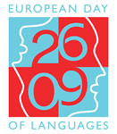
Branch school Nikola Tesla
Moravice
European Day of Languages

Slide 2
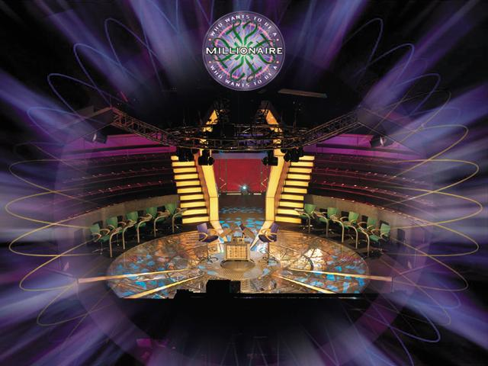


Slide 3

1 Which word means ’14’ in French?
quatre
quarante
quarante-quatre
quatorze

Slide 5
Vino tinto
2 Which phrase means ‘red wine’ in Spanish?
Vino rojo
Vino rouge
Vino roso

Slide 7
3 The world’s population is…?
4,5 billion
6,5 billion
5,5 billion
7,5 billion

Slide 9

4 What is the most commonly spoken 2nd language in the world?
English
Spanish
Chinese
Hindustani

Slide 11

5 Worldwide, how many people speak English?
550 million
300 million
450 million
800 million

Slide 13
6 What percentage of parents believe their children should learn a foreign language?
56%
74%
32%
63%

Slide 15

7 In Sweden, Denmark and the Netherlands,
what percentage of people speaks a 2nd language?
25%
55%
85%
65%

Slide 17
8 What percentage of the British people can speak another language?
33%
55%
85%
25%

Slide 19
9 In London, how many different languages are spoken?
300
100
50
500

Slide 21
10 Who said this - “If I can conquer Spanish it will be a great achievement”?
David Beckham
Thierry Henry
Antonio Banderas
Shakira

Slide 23

11 In business, how much more money can you earn if you speak another language?
£1000
£7000
£3000
£5000

Slide 25
12.Which of the following countries do not border France?
Germany
Austria
Luxembourg
Andorra

Slide 27

13 What does ‘Real’ mean in ‘Real Madrid’?
Great
Real
Important
Royal

Slide 29

14 How do you say ‘Yes’ in Polish?
Tok
Tak
Tik
Tuk

Slide 31

15 What does ‘Buona sera’ mean in English?
Good morning
Good afternoon
Good evening
Good night

Slide 33
16 What is the biggest value of the Euro note?
100
50
500
1000

Slide 35

17 Name the capital of Finland.
Helsinki
Copenhagen
Olso
Stockholm

Slide 37

18 How many countries are there in Europe?
56
44
36
26

Slide 39
19 Which is the largest city in Europe?
Madrid
Berlin
Paris
Rome

Slide 41

20 Which country does this flag belong to?
Luxembourg
France
Croatia
Bulgaria

Slide 43

21 This flag belongs to which country?
Finland
Denmark
Norway
Belgium

Slide 45





22 How many languages are there in the world?
40-60
400-600
4000-6000
40,000-60,000

Slide 47
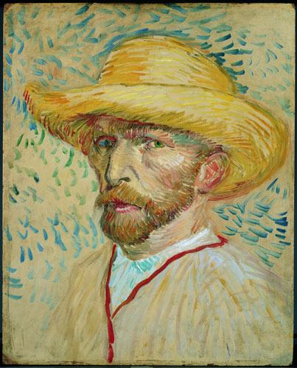
23 What nationality was Van Gogh?
Dutch
Danish
Swedish
Austrian

Slide 49
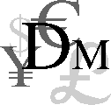
24 What % of trade does Britain export to non-English speaking countries?
12%
32%
52%
72%

Slide 51

This is the biggest brand of bread in... which country?
25
France
Spain
Germany
Italy

Slide 53
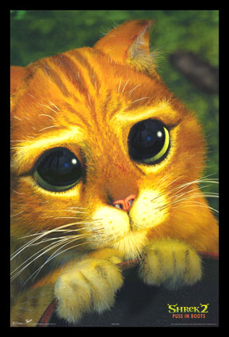
26 Which actor played ‘Puss in Boots’ in Shrek?
Eddie Murphy
Mike Myers
Antonio Banderas
Rupert Everett

Slide 55
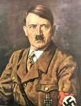
27 In which country was Adolf Hitler born?
Belgium
Germany
France
Austria

Slide 57

28 What nationality was Pope Benedict XVI?
Italian
Russian
German
Spanish

Slide 59
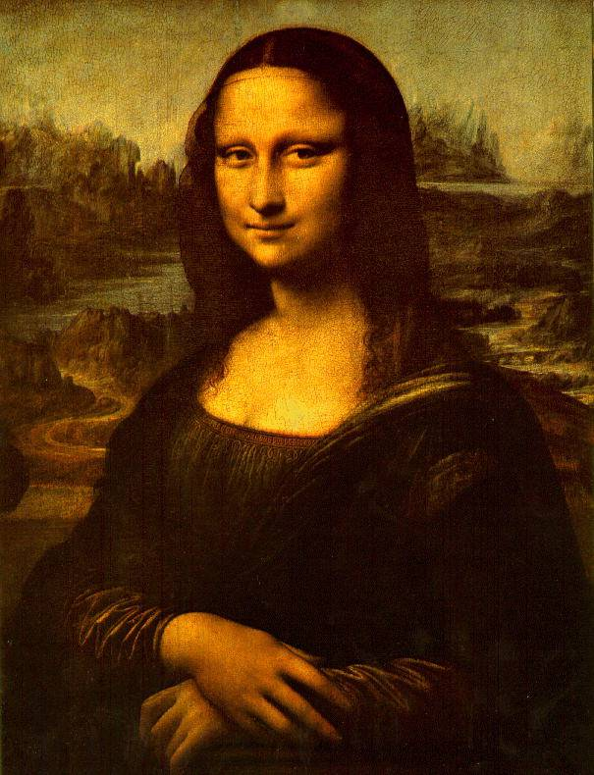
29 Who painted the Mona Lisa?
Monet
Da Vinci
Rembrant
Matisse

Slide 61
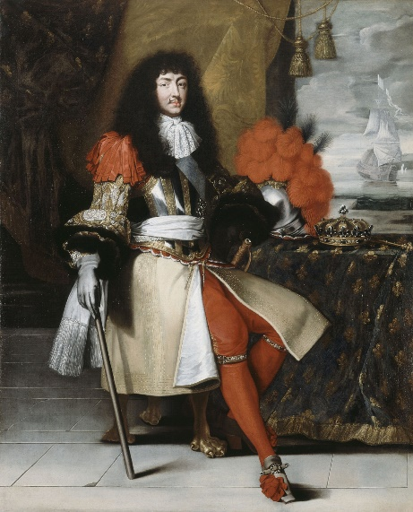
30 Who is the longest reigning European monarch?
Louis XIV, King of France
Franz Joseph I, Emperor of Austria
Elizabeth II, queen of England
Harald I, King of Norway

Slide 62
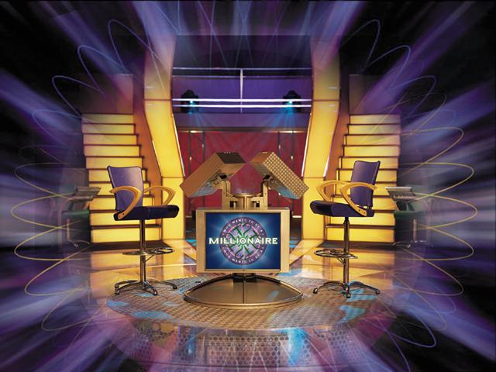

Slide 63
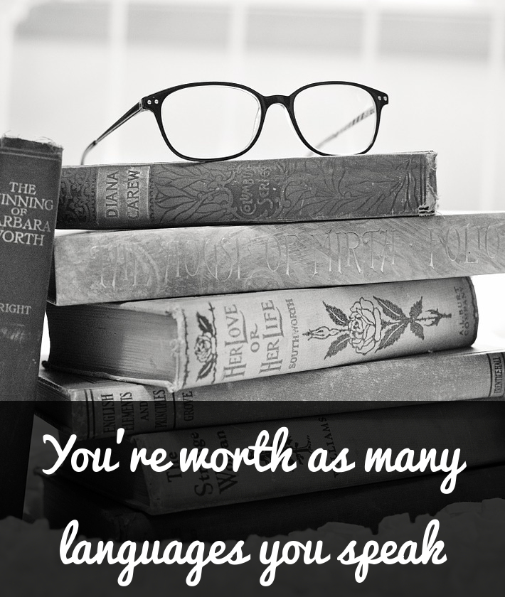
Thank you for participating in the quiz and hope you have learnt something new!

Slide 64
European Day of Languages
26th September

